Slide 1

SMART INDIA HACKATHON 2026
Problem Statement ID – SIH 26213
Problem Statement Title- AI Powered Smart
Badminton Fitness and Performance Analytics System
Theme- Fitness & Sports
PS Category- Hardware
Team Name : NOVA TITANS
Team ID : 15

Slide 2
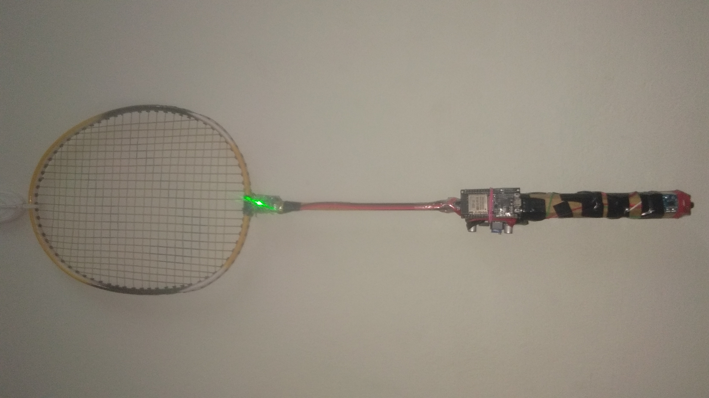
AI Powered Smart Badminton Fitness and
Performance Analytics System
NOVA TITANS
Our Proposed Solution :
Problem / Challenge :
1. AI/ML-Based Player Assessment – Analyse strokes and performance using sensor data.
2. Personalized Training Analytics – Track individual baselines, strengths and improvement.
3. Fitness & Performance Monitoring – Monitor intensity, consistency, workload and fatigue.
4. Smart Player Profiling – Combine session and benchmark data for player insights.
5. Affordable Smart-Racket Platform – Provide a compact solution for training and assessment.
1. Players evaluated mostly via coach observation without objective, measurable metrics
2. Missing personalized progress analytics to track player improvement across sessions.
3. Lack of data on stroke speed, intensity, consistency, and fatigue during training.
Existing Solutions :
1. Current systems track basic stroke counts, swing speed, and activity using standard wearable sensors and IMUs.
Innovation and Uniqueness :
1. Dual-Signal Stroke Validation – IMU confirms racket–shuttle impact.
2. Two-Stage Data Processing – Threshold detection followed by ML analysis.
3. Multi-Model Intelligence – Separate ML models for stroke and intensity classification.
4. Benchmark Gap Analysis – Compare player data with trained pro-player reference data.

Slide 3
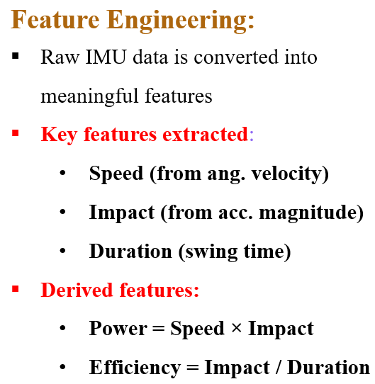
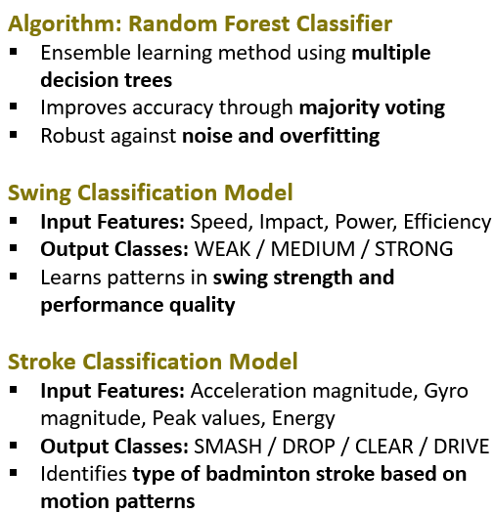
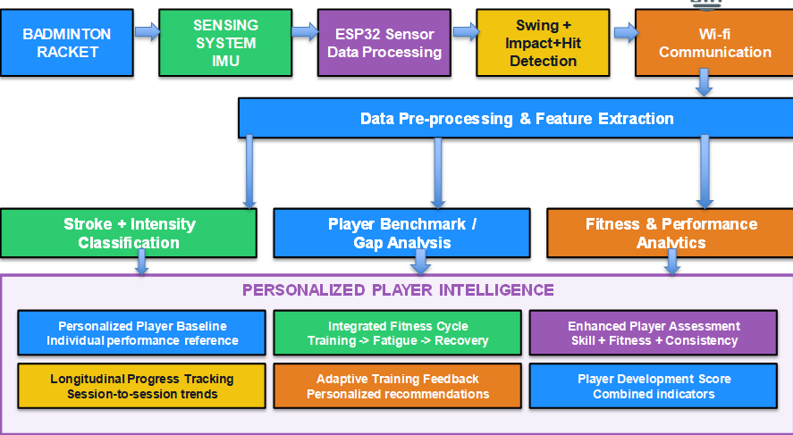
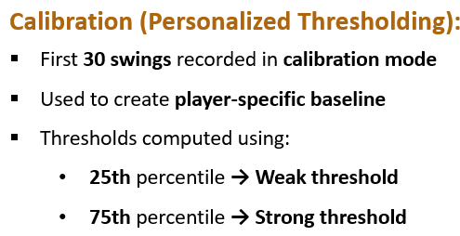
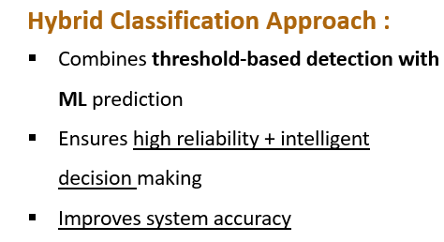
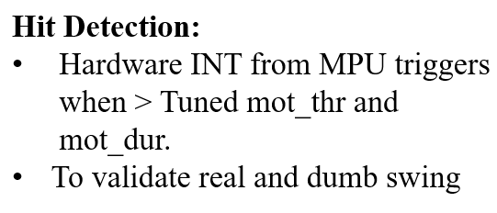
NOVA TITANS
TECHNICAL APPROACH

Slide 4
NOVA TITANS
GAP ANALYSIS: COMMERCIAL VS OUR PRODUCT
Commercial product | Product link / article | Limitation of the commercial product | Our Features (Price: ₹2,000)
Victor "Intelligence" smart racket chip Handle end-cap sensor; app for smash power, shot mix, session trends. Price: not announced | Breath Badminton article Badminton Insight video | Unreleased; only smash power and shot mix. | Injury prediction, swing filter, intensity classes, pro benchmark.
Coollang Xiaoyu 2.0 / 3.0 Racket-end Bluetooth sensor. Price: ~₹7,320 | Coollang product page | No drop shot, benchmark or injury prediction. | Drop-shot detection, intensity classes, pro benchmark, injury prediction.
STA 3.0 Smart Badminton Swing Analyzer Racket sensor + phone app. Price: ₹11,520 | STA product page | Only shot count, speed and calories. | Stroke classes, intensity, swing filter, tracking, injury prediction.
Usense Badminton Performance Sensor 8 g racket sensor with 3D replay. Price: ₹6,790 | BadmintonBay product page | Only swing replay and string advice. | Stroke and intensity classes, swing filter, injury prediction.
Garmin "Badminton AI" watch app Wrist accelerometer stroke counter. Price: ~₹770 one-time (app) + Garmin watch | Garmin Connect IQ store | Only counts strokes; needs a Garmin watch. | Racket-mounted IMU: stroke, intensity, validity and injury prediction.
Notes:
Victor "Intelligence" smart racket chip
https://breathbadminton.com/smart-badminton-racket-victor-intelligence-new/
https://www.youtube.com/watch?v=fioHQbU0Quo
Coollang Xiaoyu 2.0 / 3.0
https://www.coollang-asia.com/badminton-sensor
STA 3.0 Smart Badminton Swing Analyzer
https://www.supremetennisathlete.com/products/sta-smart-badminton-training-swing-analyzer-bluetooth-activity-tracker-compatible-with-android-ios-phone
Usense Badminton Performance Sensor
https://www.badmintonbay.com/usense-wireless-badminton-sensor-tracker.html
Garmin "Badminton AI" watch app
https://apps.garmin.com/en-US/apps/48d817d2-364e-486d-8209-1e7483b96d5f

Slide 5
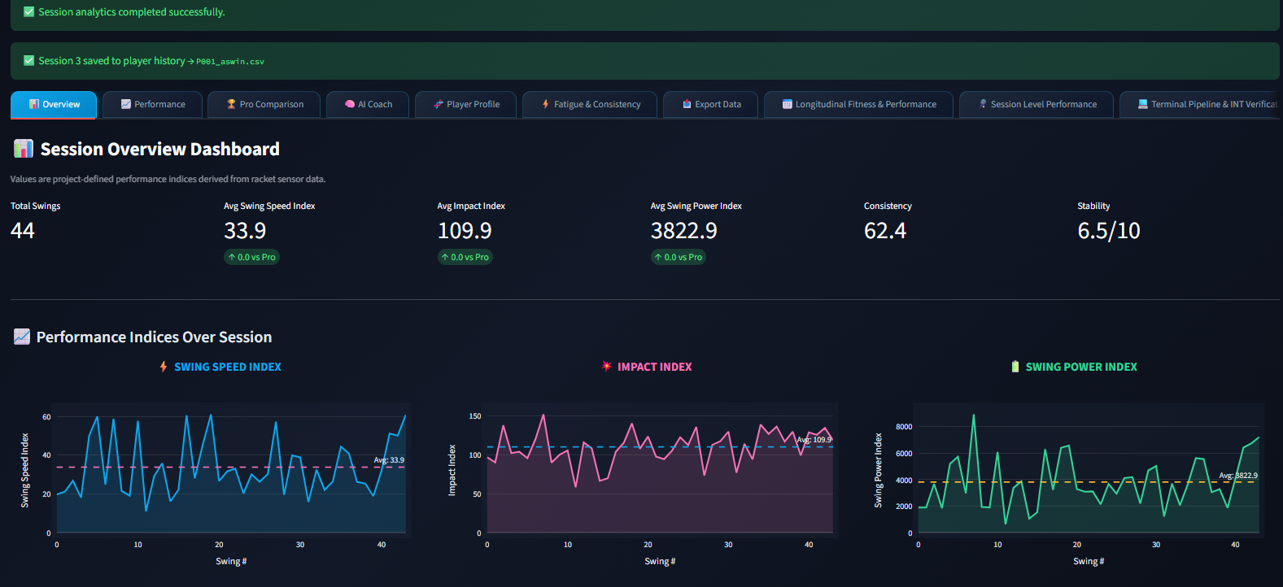
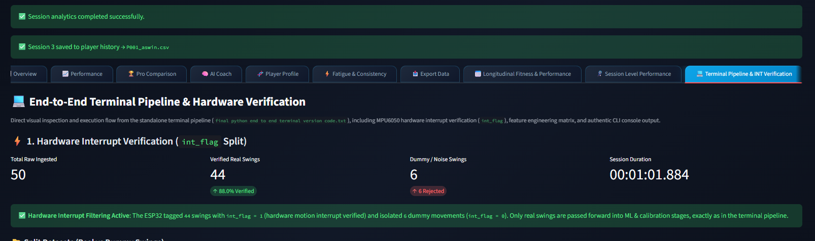
FEASIBILITY AND VIABILITY
NOVA TITANS
Performance Dashboard
Technical Feasibility
1. Product uses readily available imu and esp32 hardware.
2. Modular design supports future sensor and analytics upgrades.
Challenges
1. Sensor Noise: Racket vibration may cause false impact detection.
2. Power: Data loss and battery consumption during continuous operation.
3. Personalization: Different playing styles make universal baselines difficult.
Solutions
1. IMU filtering and player-specific calibration.
2. Data buffering for communication reliability.
3. Longitudinal analysis and Multi-session baselines for efficiency and personalization.

Slide 6
IMPACT AND BENEFITS
NOVA TITANS
Target Audience Impact Analysis
Players & Beginners
Get measurable feedback on stroke quality, consistency and progress. Identify individual strengths and areas for improvement.
Coaches & Badminton Academies
Enable data-driven player evaluation beyond visual observation. Monitor player performance and development across training sessions. Identify training needs and support personalized coaching strategies.
Schools & Talent Programs
Enable low-cost talent identification and structured grassroots coaching across schools, colleges and district academies.
Benefits Analysis
Training & Performance Benefits
Enables session-wise and long-term performance tracking. Helps establish measurable benchmarks for player development.
Scalability & Technology Benefits
Modular IMU design can extend to other racket sports through retrained ML models, with cloud-ready data pipelines for future upgrades.
Economic Benefits
Affordable and portable compared with high-end sports analytics systems. Can be deployed across multiple players and training centres at relatively low hardware cost.

Slide 7
RESEARCH AND REFERENCES
NOVA TITANS
1. Wearable Sensing & AI
Jin, G., LI, X. Wearable sensing for badminton stroke recognition with one-dimensional convolutional neural network. Sci Rep 15, 41236 (2025). https://doi.org/10.1038/s41598-025-25158-2
2. Badminton Biomechanics & Performance Dataset
Seong, M., Kim, G., Yeo, D. et al. MultiSenseBadminton: Wearable Sensor–Based Biomechanical Dataset for Evaluation of Badminton Performance. Sci Data 11, 343 (2024). https://doi.org/10.1038/s41597-024-03144-z
3. AI-Based Badminton Motion Analysis
Zhu, X., Liu, L., Huang, J. et al. The analysis of motion recognition model for badminton player movements using machine learning. Sci Rep 15, 19030 (2025). https://doi.org/10.1038/s41598-025-02771-9
Jacob, Alvin, Wan Nurshazwani Wan Zakaria, and Mohd Razali Bin Md Tomari. "Implementation of IMU sensor for elbow movement measurement of badminton players." 2016 2nd IEEE International Symposium on Robotics and Manufacturing Automation (ROMA). IEEE, 2016.
Li, Li, and Feng Li. "Recognizing badminton hitting movements Based on Multi-sensor trajectory recognition algorithm." 2023 3rd International Conference on Information Technology and Contemporary Sports (TCS). IEEE, 2023.

